Slide 1



Open Educational Resource Adoption: the Who, Why, What, Where, and How?
Una Daly, Open Education Consortium
with Special Guest Faculty
July 29, 2016
Notes:
Students cannot afford textbooks so they are going without – effects learning, success, and completion
OER is available on DAY ONE

Slide 2


Welcome
Special Guests
David Devine, PhD, Physics Professor, Coastline College
Alex Parisky, PhD, STEM Professor & Developer, University of Hawaii at Windward
Scott Davis, English Professor, Coastline College
Una Daly, CCCOER Director
Instructional Designer @One and Foothill College
http://oerconsortium.org

Slide 3


Community College Consortium for OER
Adoption of high-quality open educational resources
Faculty choice & development
Student success
Image: Come In, We're Open by Gary Simmons cc-by-nc-sa flickr
Notes:
The Community College Consortium for OER is a community of practice dedicated to promoting the adoption and development of open educational resources to enhance teaching and learning. We were founded to support the community college mission of open access through creating awareness and development of openly licensed, low-cost education materials to make college more affordable and accessible for students. We provide regularly scheduled online and face-2-face workshops for faculty and staff who are engaged in OER projects.

Slide 4
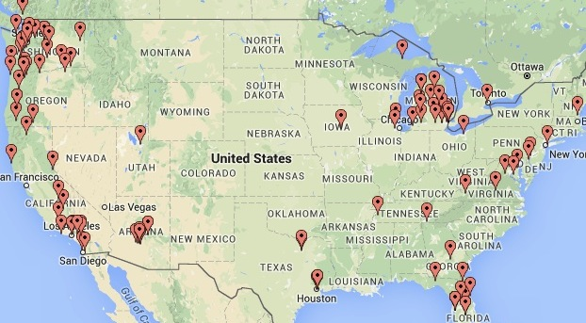
250+ Colleges in 21 States
& Provinces
California Community College Chancellor’s Office
Notes:
Seven system offices: British Columbia, California, Florida, Michigan, Oregon, Virginia, and Washington. Out most recent members are Lakeland College Ilinois, Bay College in Michigan and Alamo County College District and Dallas Community College District, in TEXAS.

Slide 5
Agenda
Quiz Show
What’s the problem?
Definitions and licensing
Searching
Adoption processes
Planning for OER sustainability
Questions

Slide 6

OER Quiz

Slide 7
Are all Open Educational
Resources in the Public Domain?
True
False

Slide 8

Open Educational Resources
  Teaching, learning, & research resources that reside in the public domain
  OR
  have been released under an intellectual property license
  permitting their free use and repurposing.
cc-by donkyhotey/flickr

Slide 9
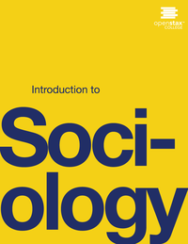



Examples
Lesson plans
Open Courseware
Open textbooks
Videos
Images
Tests
Software
Tools, materials, or techniques to access
knowledge freely
Notes:
Atkins, D. E., J. S. Brown and A. L. Hammond, 2007. A Review of the Open Educational Resources (OER) Movement: Achievements, Challenges, and New Opportunities, Report to The William and Flora Hewlett Foundation.

Slide 10
Are eBooks the same as open textbooks?
True
False

Slide 11
ebook vs. Open Textbooks
Feature | eBooks | Open Textbooks
PRINTING | Some printing restrictions | No printing restrictions
DEVICES | Restriction on how many devices can access | Can load on any number of devices
EXPIRATION | Many expire after one or two semesters | You can retain a copy indefinitely
PRICE | Varies greatly and no resale value of hard copy | Free online and usually $20-50 for hard copy
http://www.huffingtonpost.com/ethan-senack/etextbooks-vs-open-textbo_b_8547630.html

Slide 12
By what % have textbook prices risen in the last 12 years?
51 – 60%
61 – 70%
71 – 80%
Over 80%

Slide 13
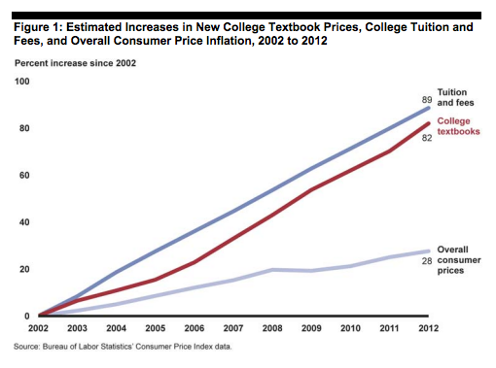
Source: Government Accountability Office, June 2013, College Textbooks Report

Slide 14

Student Impact
Survey of 2039 students at 156 campuses across 33 states
48% take fewer classes or different classes
65% choose to not buy textbook
94% report concern that grades affected
Source: Fixing the Broken Textbook Market, 2014

Slide 15

Taxpayer Impact
30% of students used financial aid to buy textbooks
  $300+ (on average) per semester
  50% of community college students
$3 billion in financial aid used yearly for undergraduate textbooks
Student PIRGs Survey, Covering the Cost, 2016
Notes:
24% of students at 4-year college or university use financial aid to pay for

Slide 16

Solution:
Open Educational Resources
• Online access to textbook on first
day of class.
Free online, low-
cost print option
Faculty can adapt for students
Licensed for re-use by OpenSourceWay

Slide 17


CA State Funding Available
Textbook Affordability Act of 2015
$5 Million for Community College OER Degree programs approved 2016-17 state budget

Slide 18
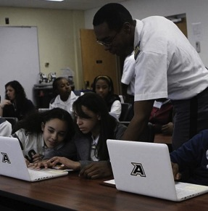
Education is about Sharing
Teachers share knowledge freely
Students share
their understanding
Teachers share
with each other.
Source: David Wiley, Why be Open, slideshare 2012

Slide 19
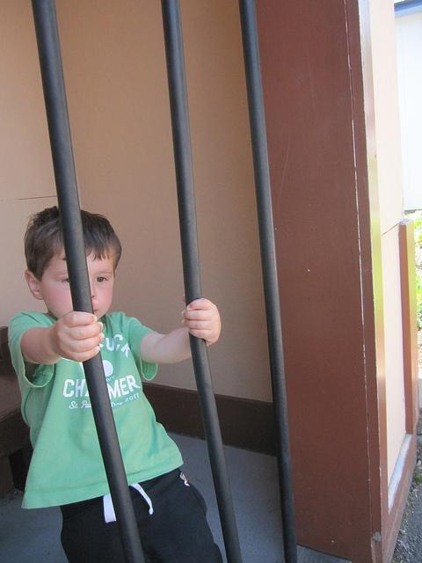
But how to set the content free?
"Breaking out of Jail" by redjar is licensed under CC BY-SA 2.0

Slide 20




Creative Commons Licenses
Simple, standardized way to grant copyright permissions
Permission:
Attribute
Commercial?
Share alike?

Slide 21
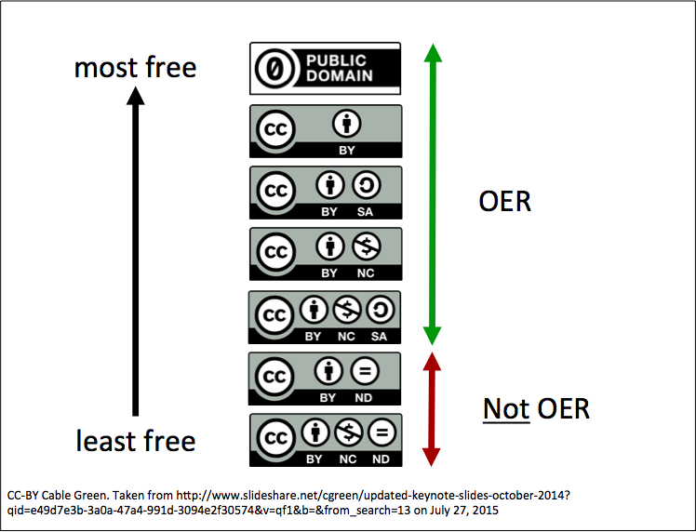
Over 1 Billion Licensed Works

Slide 22
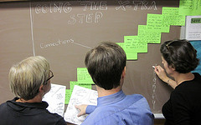
Faculty Choice
No more covering extra chapters because book is so expensive
No requirement to change
versions every few years.
You can customize your instructional materials
Many open textbooks have ancillaries
Image: faculty meeting fun by alex ragone cc-by-nc-sa

Slide 23
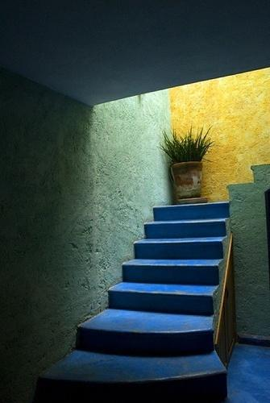
Steps to Adopt
Open Educational Resources
• Discover & Select
• Adopt & Use
• Grow & Sustain

Slide 24

Openly Licensed Materials
Google Images
  Advanced search settings
YouTube
  Use Filter for creative commons
Flickr
  Go directly to Flickr.com/CreativeCommons
Image: film clip from pixabay.com
Notes:
Creative Commons website also has a search page which allows you to search for openly licensed video, music, images, etc.

Slide 25
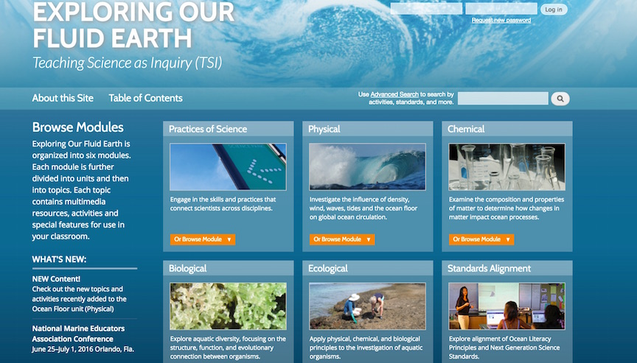
OER in STEM Disciplines
Alex Parisky, PhD
University of Hawaii, Windward

Slide 26











Peer Reviewed OER Sites
Notes:
Difference between Referral Lists and Repositories of Open Textbooks. Curated content and peer reviews and ranking and ratings.

Slide 27
50 Highest Impact College Courses
Accounting
Art History
Biology
Business
Chemistry
Child Development
Communication
Computer Science
Economics
Education
English
Electronic Media
Geography
History
Kinesiology
Math
Music
Philosophy
Physics
Political Science
Psychology
Sociology
Spanish
Statistics
http://cool4ed.org

Slide 28
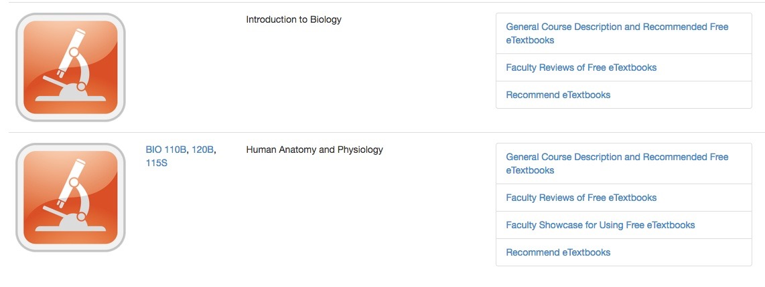
Peer Reviewed Open Textbooks
http://cool4ed.org/courseshowcase.html

Slide 29
Faculty Adoption Showcases
Course description
Syllabus
Open textbook
Ancillaries
Sample assignment
Student feedback
Lessons learned
Faculty/college profile
http://cool4ed.org/facultyshowcase.html

Slide 30

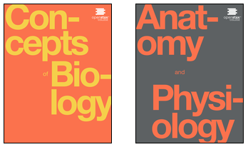










$ 39 Million in savings 2015-16
$13 MILLION+ SAVED!
Foundation funded, peer reviewed open textbooks for top 25 courses. Ancillaries available.
http://openstax.org/subjects
Notes:
One notable project is OpenStax College based at Rice University, which is publishing 20 open textbooks for the highest enrollment courses in U.S. schools.
Foundation funded: Hewlett, Gates, 20 Million Minds, Maxfield, Rice University Funded. Includes ancillaries such a power points, test banks, online homework systems, study aides

Slide 31

Open Textbook Adoption
David Devine, Faculty, Coastline College

Slide 32

Open Textbook Library
Browse for open textbooks by subject
Easy user interface with peer reviews
All textbooks are complete and openly licensed
Faculty from any institution are encouraged to contribute peer reviews to site.
http://open.umn.edu/opentextbooks/

Slide 33
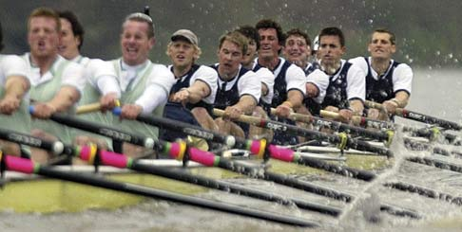
Teamwork
Find an OER in your discipline and verify its creative commons license

Slide 34

Share your impressions of the OER including the open license type

Slide 35

Steps to Adopt
Open Educational Resources
• Discover & Select
• Adopt & Use
• Grow & Sustain
San Miguel stairs cc licensed by larry&flo 2007
35
How to Adopt an Open Textbook – Adopt & Use Section
35

Slide 36
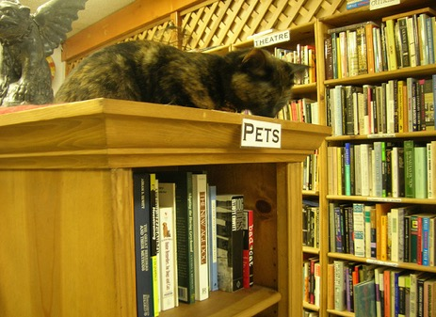
Adopt and Use
Who needs to know?
What are the deadlines?
How will students access?
Is funding available?
brewbooks flickr CC-BYNCSA
How to Adopt an Open Textbook -- Adopt & Use Section
36
36

Slide 37
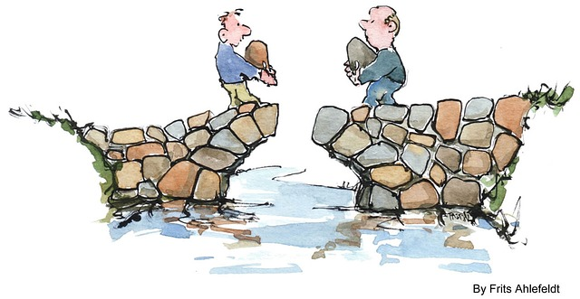

Work with stakeholders
What is the process and timing?
  Curriculum Committee
  Department Head
  Bookstore
  Librarians
  Ed Tech / LMS
  Students
Image
pixabay.com

Slide 38
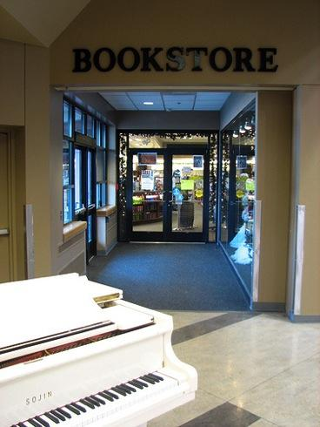
College Bookstores
Textbook information hub on campus
Ask them to participate
Print copies
Lower Columbia College Flickr CC-BYNCND
How to Adopt an Open Textbook – Adopt & Use Section

Slide 39
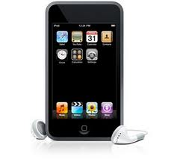
Student Access
What formats do students want?
How to distribute?
  Digital
  Print copies
Inform the library and IT help desk
https://vimeo.com/78298095

Slide 40

Remix OER?
Formatting
508/ADA Accessibility
Licensing
"DJ SPANGDAHLEM AIR BASE" by Spangdahlem Air Bas. Licensed under Public Domain via Commons -

Slide 41
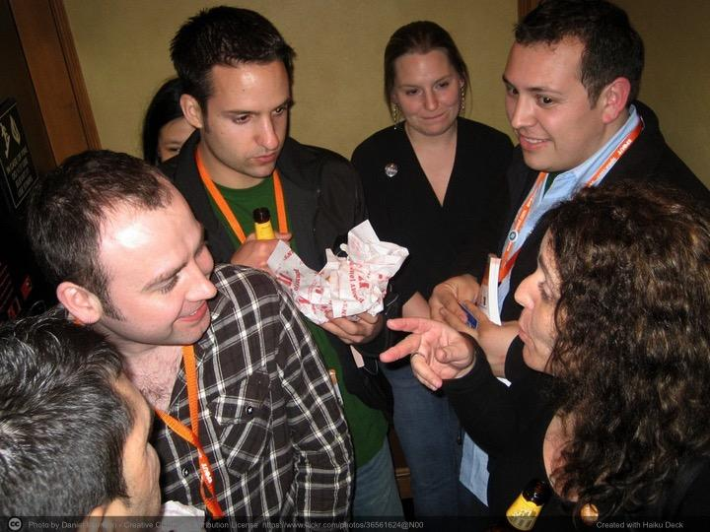
Group Discussion
Who are the stakeholders and what is your elevator speech?

Slide 42
Steps to Adopt
Open Educational Resources
Discover & Select
Adopt & Use
Grow & Sustain
San Miguel stairs creative commons licensed by larry&flo 2007
How to Adopt an Open Textbook
42
42

Slide 43


"Remote Marathon" by Marines is licensed under CC BY-NC 2.0

Slide 44

Plan for Success
Form the team
Establish the goal
Build awareness
Professional development
Student engagement
Align with other college initiatives
Vision" by Mélanie Plante is licensed under CC BY 2.0

Slide 45
Open Textbook Project
Scott Davis
College OER Coordinator
English Faculty

Slide 46
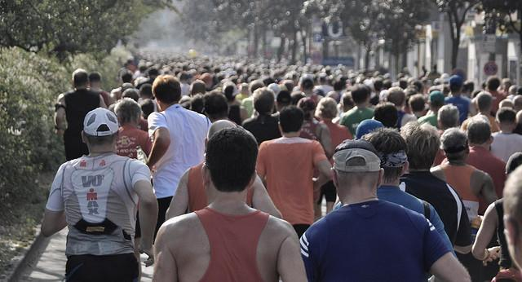
Persistence
"Berlin Marathon" by akiwitz is licensed under CC BY 2.0

Slide 47
OER Research
California OER Council White Paper
Washington’s SBCTC Faculty OER Usage Study
Open Education Group at BYU
OER Research Hub at Open University
Babson’s Opening the Textbook Report (2016)

Slide 48
Released April 1, 2016
Permalink for online version: http://tinyurl.com/WPOERAdoption040116
Printable PDF with Appendices: http://tinyurl.com/WPOERPrintVersion2
Video Synopsis: https://www.youtube.com/edit?o=U&video_id=vwVIrv0iSgE

Slide 49
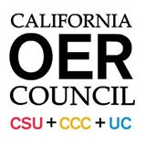
16 faculty shared perceptions about their use of OER
12 of 16 faculty rated the OER textbook equivalent or superior to the traditional textbook for the course.
Faculty were concerned about support materials (PowerPoints, Test banks) available for OER textbooks.
  50% felt that the support materials lacked quality.
  25% of faculty felt that implementing the support materials took a significant amount of time.

Slide 50
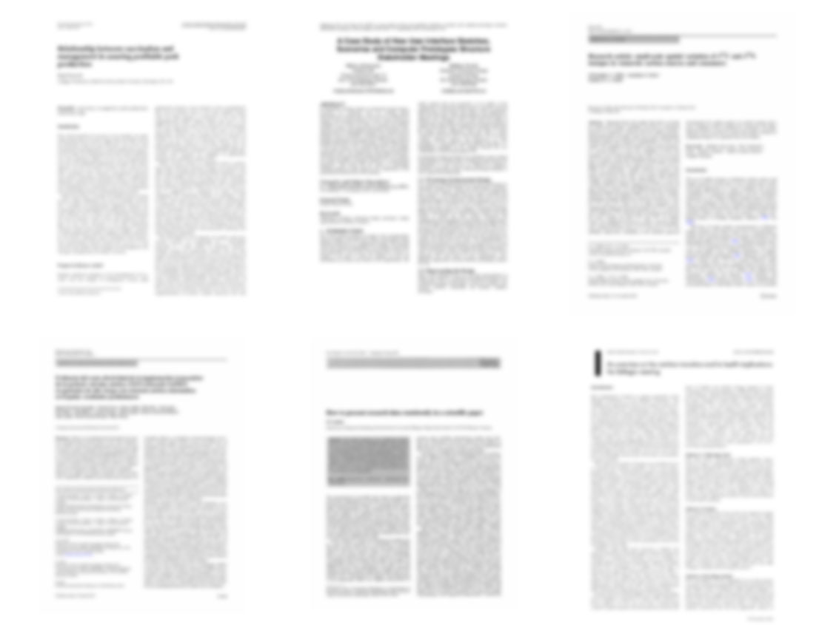
13 Peer Reviewed Studies
of OER Efficacy
http://openedgroup.org/
"Recent Studies in OER Adoption, May 2016" by John Hilton III, Open Education Group
Notes:
Across 13 academic studies that attempted to measure results pertaining to student learning (higher ed: 15784 treatment, 99,692 control, k12: 1805 treatment 2439 control) none showed results in which students who utilized OER performed worse than their peers who used traditional textbooks.
Allen, G., Guzman-Alvarez, A., Molinaro, M., Larsen, D. (2015). Assessing the Impact and Efficacy of the Open-Access ChemWiki Textbook Project. Educause Learning Initiative Brief, January 2015. See also this newsletter. Bowen, W. G., Chingos, M. M., Lack, K. A., & Nygren, T. I. (2012). Interactive Learning Online at Public Universities: Evidence from Randomized Trials. Ithaka S+R. Bowen, W. G., Chingos, M. M., Lack, K. A., & Nygren, T. I. (2014). Interactive Learning Online at Public Universities: Evidence from a Six‐Campus Randomized Trial. Journal of Policy Analysis and Management, 33(1), 94-111. Feldstein, A., Martin, M., Hudson, A., Warren, K., Hilton, J., & Wiley, D. (2012). Open textbooks and increased student access and outcomes. European Journal of Open, Distance and E-Learning. Retrieved from http://www.eurodl.org/index.php?p=archives&year=2012&halfyear=2&article=533. Gil, P., Candelas, F., Jara, C., Garcia, G., Torres, F (2013). Web-based OERs in Computer Networks. International Journal of Engineering Education, 29(6), 1537-1550. (OA preprint) Hilton, J., Gaudet, D., Clark, P., Robinson, J., & Wiley, D. (2013). The adoption of open educational resources by one community college math department. The International Review of Research in Open and Distance Learning, 14(4), 37–50. Hilton, J., & Laman, C. (2012). One college’s use of an open psychology textbook. Open Learning: The Journal of Open and Distance Learning, 27(3), 201–217. Retrieved from http://www.tandfonline.com/doi/abs/10.1080/02680513.2012.716657. (Open Repository Preprint). Lovett, M., Meyer, O., & Thille, C. (2008). The open learning initiative: Measuring the effectiveness of the OLI statistics course in accelerating student learning. Journal of Interactive Media in Education, 2008 (1). Pawlyshyn, Braddlee, Casper and Miller (2013). Adopting OER: A Case Study of Cross-Institutional Collaboration and Innovation. Educause Review. Robinson, T.J. (2015). Open Textbooks: The Effects of Open Educational Resource Adoption on Measures of Post-secondary Student Success (Doctoral dissertation). Robinson T. J., Fischer, L., Wiley, D. A., & Hilton, J. (2014). The impact of open textbooks on secondary science learning outcomes. Educational Researcher, 43(7): 341-351. Wiley, D., Hilton, J. Ellington, S., and Hall, T. (2012). “A preliminary examination of the cost savings and learning impacts of using open textbooks in middle and high school science classes.” International Review of Research in Open and Distance Learning. 13 (3), pp. 261-276.
This also includes Fischer et al (2015), Wiley et al. (EPAA) (2016), and Hilton et al. (IRRODL) (in press)

Slide 51

119,720 Students
http://openedgroup.org/
"Recent Studies in OER Adoption, May 2016" by John Hilton III, Open Education Group
Notes:
Across 13 academic studies that attempted to measure results pertaining to student learning (higher ed: 15784 treatment, 99,692 control, k12: 1805 treatment 2439 control) none showed results in which students who utilized OER performed worse than their peers who used traditional textbooks.
Allen, G., Guzman-Alvarez, A., Molinaro, M., Larsen, D. (2015). Assessing the Impact and Efficacy of the Open-Access ChemWiki Textbook Project. Educause Learning Initiative Brief, January 2015. See also this newsletter. Bowen, W. G., Chingos, M. M., Lack, K. A., & Nygren, T. I. (2012). Interactive Learning Online at Public Universities: Evidence from Randomized Trials. Ithaka S+R. Bowen, W. G., Chingos, M. M., Lack, K. A., & Nygren, T. I. (2014). Interactive Learning Online at Public Universities: Evidence from a Six‐Campus Randomized Trial. Journal of Policy Analysis and Management, 33(1), 94-111. Feldstein, A., Martin, M., Hudson, A., Warren, K., Hilton, J., & Wiley, D. (2012). Open textbooks and increased student access and outcomes. European Journal of Open, Distance and E-Learning. Retrieved from http://www.eurodl.org/index.php?p=archives&year=2012&halfyear=2&article=533. Gil, P., Candelas, F., Jara, C., Garcia, G., Torres, F (2013). Web-based OERs in Computer Networks. International Journal of Engineering Education, 29(6), 1537-1550. (OA preprint) Hilton, J., Gaudet, D., Clark, P., Robinson, J., & Wiley, D. (2013). The adoption of open educational resources by one community college math department. The International Review of Research in Open and Distance Learning, 14(4), 37–50. Hilton, J., & Laman, C. (2012). One college’s use of an open psychology textbook. Open Learning: The Journal of Open and Distance Learning, 27(3), 201–217. Retrieved from http://www.tandfonline.com/doi/abs/10.1080/02680513.2012.716657. (Open Repository Preprint). Lovett, M., Meyer, O., & Thille, C. (2008). The open learning initiative: Measuring the effectiveness of the OLI statistics course in accelerating student learning. Journal of Interactive Media in Education, 2008 (1). Pawlyshyn, Braddlee, Casper and Miller (2013). Adopting OER: A Case Study of Cross-Institutional Collaboration and Innovation. Educause Review. Robinson, T.J. (2015). Open Textbooks: The Effects of Open Educational Resource Adoption on Measures of Post-secondary Student Success (Doctoral dissertation). Robinson T. J., Fischer, L., Wiley, D. A., & Hilton, J. (2014). The impact of open textbooks on secondary science learning outcomes. Educational Researcher, 43(7): 341-351. Wiley, D., Hilton, J. Ellington, S., and Hall, T. (2012). “A preliminary examination of the cost savings and learning impacts of using open textbooks in middle and high school science classes.” International Review of Research in Open and Distance Learning. 13 (3), pp. 261-276.
This also includes Fischer et al (2015), Wiley et al. (EPAA) (2016), and Hilton et al. (IRRODL) (in press)

Slide 52
95% Same or Better Outcomes
http://openedgroup.org/
"Recent Studies in OER Adoption, May 2016" by John Hilton III, Open Education Group
Notes:
Across 13 academic studies that attempted to measure results pertaining to student learning (higher ed: 15784 treatment, 99,692 control, k12: 1805 treatment 2439 control) none showed results in which students who utilized OER performed worse than their peers who used traditional textbooks.
Allen, G., Guzman-Alvarez, A., Molinaro, M., Larsen, D. (2015). Assessing the Impact and Efficacy of the Open-Access ChemWiki Textbook Project. Educause Learning Initiative Brief, January 2015. See also this newsletter. Bowen, W. G., Chingos, M. M., Lack, K. A., & Nygren, T. I. (2012). Interactive Learning Online at Public Universities: Evidence from Randomized Trials. Ithaka S+R. Bowen, W. G., Chingos, M. M., Lack, K. A., & Nygren, T. I. (2014). Interactive Learning Online at Public Universities: Evidence from a Six‐Campus Randomized Trial. Journal of Policy Analysis and Management, 33(1), 94-111. Feldstein, A., Martin, M., Hudson, A., Warren, K., Hilton, J., & Wiley, D. (2012). Open textbooks and increased student access and outcomes. European Journal of Open, Distance and E-Learning. Retrieved from http://www.eurodl.org/index.php?p=archives&year=2012&halfyear=2&article=533. Gil, P., Candelas, F., Jara, C., Garcia, G., Torres, F (2013). Web-based OERs in Computer Networks. International Journal of Engineering Education, 29(6), 1537-1550. (OA preprint) Hilton, J., Gaudet, D., Clark, P., Robinson, J., & Wiley, D. (2013). The adoption of open educational resources by one community college math department. The International Review of Research in Open and Distance Learning, 14(4), 37–50. Hilton, J., & Laman, C. (2012). One college’s use of an open psychology textbook. Open Learning: The Journal of Open and Distance Learning, 27(3), 201–217. Retrieved from http://www.tandfonline.com/doi/abs/10.1080/02680513.2012.716657. (Open Repository Preprint). Lovett, M., Meyer, O., & Thille, C. (2008). The open learning initiative: Measuring the effectiveness of the OLI statistics course in accelerating student learning. Journal of Interactive Media in Education, 2008 (1). Pawlyshyn, Braddlee, Casper and Miller (2013). Adopting OER: A Case Study of Cross-Institutional Collaboration and Innovation. Educause Review. Robinson, T.J. (2015). Open Textbooks: The Effects of Open Educational Resource Adoption on Measures of Post-secondary Student Success (Doctoral dissertation). Robinson T. J., Fischer, L., Wiley, D. A., & Hilton, J. (2014). The impact of open textbooks on secondary science learning outcomes. Educational Researcher, 43(7): 341-351. Wiley, D., Hilton, J. Ellington, S., and Hall, T. (2012). “A preliminary examination of the cost savings and learning impacts of using open textbooks in middle and high school science classes.” International Review of Research in Open and Distance Learning. 13 (3), pp. 261-276.
This also includes Fischer et al (2015), Wiley et al. (EPAA) (2016), and Hilton et al. (IRRODL) (in press)

Slide 53


Join our Community
Access to a community of OER experts
Online advisory email list
Professional development
Collaboration opportunities
Online Resources
Twitter : @cccoer, @unatdaly
http://www.slideshare.net/UnaDaly/
http://oerconsortium.org

